Slide 1


TAX REMITTANCE IN A SEAMLESS AND CONVENIENT FASHION USING SMARTKOMMS GATEWAY SOLUTION (TECHNOLOGY FOR THE FUTURE)
A PRESENTATION TO PROMOTE AND IMPROVE REVENUE GENERATION THROUGH AN EFFECTIVE TAX COLLECTION PLATFORM
Presented By SMARTKOMMS

Slide 2
TABLE OF CONTENTS
INTRODUCTION
TAX REMITTANCE ISSUES (FACTS AND FIGURES)
BAMS OVERVIEW AND FEATURES
BAMS AS A TOOL FOR SEAMLESS TAX REMITTANCES
PROCESS FLOW AND SCREEN SHOTS
BENEFITS
CONCLUSION

Slide 3
INTRODUCTION
Formal introduction of tax system in Nigeria by Lord Lugard Stamp Duties (1903) and Native Revenue proclamation (1906) (What, Whom, Where and When) to pay.
The present form of Nigerian taxation can be traced back to 1914 starting with
Proclamation Law 1914
Native Ordinance 1917
The Non-natives Protectorates Tax Ordinance 1931
Raisman Commission 1958
Raisman Commission introduced the standardized tax principles. The recommendations from the Commission were later accepted and adopted by the National Government. These recommendations became the part of the Nigeria`s Constitution. The constitution gave birth to the Income Management Act and Companies Income Tax Act in 1961

Slide 4
INTRODUCTION CONT’D
Three legal bodies authorized to levy taxes on the Nigerian citizenry are:
Federal Internal Revenue Service: Responsible for Capital Gain Tax, Educational Tax, Value Added tax, Withholding tax, Companies Income Tax, Personal Income tax.
State Boards of Internal Revenue: Responsible for Road Taxes, individual capital gains, individual withdrawing.
Local Government Revenue Service: Responsible for collecting taxes on the local governments level.

Slide 5
TAX REMITTANCE ISSUES (FACTS AND FIGURES)
Tax remittance situation in the country is worsened by the largely bureaucratic manual tax administration system rather than a technology driven risk based approach
Expected estimated revenue from non-oil revenues largely comprising Company Income Tax, Value Added Tax, Customs & Excise Duties is put at 1.373 trillion naira about (28%) of the projected revenue for the country.
Nigeria ranks 182 out of 190 benchmarked economies on the Paying Taxes sub-index under the Ease of Doing Business index for 2017. The distance to frontier score is 28.09%, which implies that Nigeria is about 72% away from the best performance observed under the Paying Taxes sub-index.
Nigeria’s tax revenue to GDP ratio is currently 6.1%, a far cry when compared to its fellow African counterparts such as Ghana (20.8%), Algeria (64.05%) and South Africa (26.9%)

Slide 6
BAMS OVERVIEW AND FEATURES
The Bank Account Monitoring System (BAMS) is a web based system developed for day to day management of all bank accounts of a state and corporate organizations.
It is a technology solution that leverages on services from Nigerian Inter Bank Settlement System (NIBSS) to provide a secured, reliable and effective payment gateway for various types of financial transactions
State Governments and corporate organizations operate various bank accounts in several Banks for its everyday financial activities.
BAMS provides a monitoring tool that enables institutions (Corporate and Government) perform the following:
View account balances of all accounts owned across all banks
Perform various analysis with this information
Move funds from account to another, as well as make payments to vendors/contractors, staff salaries etc. in a seamless fashion.
Make tax remittances to the appropriate tax authorities in real time at the point of transactional payments

Slide 7
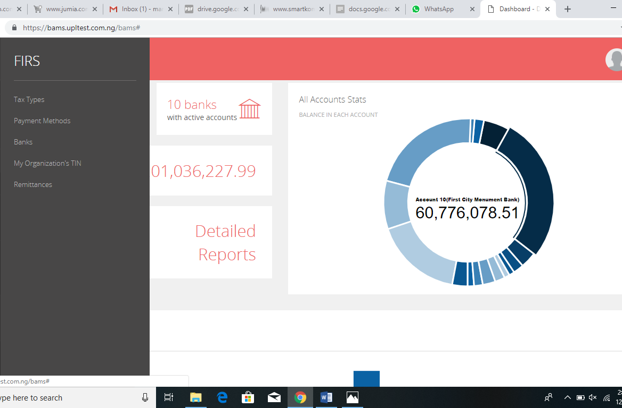
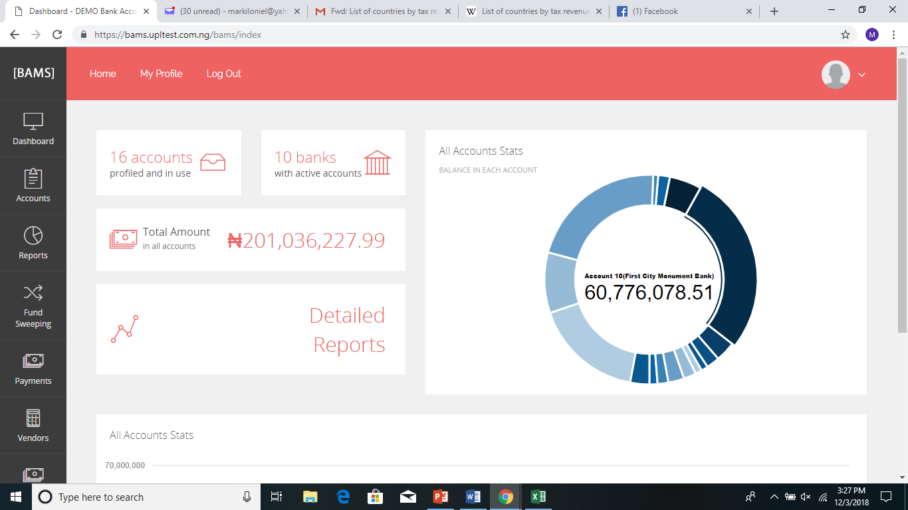
BAMS AS A TOOL FOR SEAMLESS TAX REMITTANCE
Dashboard of the FIRS platform on BAMS for the purpose of tax remittance
Displays the various tax types, payment methods, all available Banks, TIN verification and Remittances processing.

Slide 8
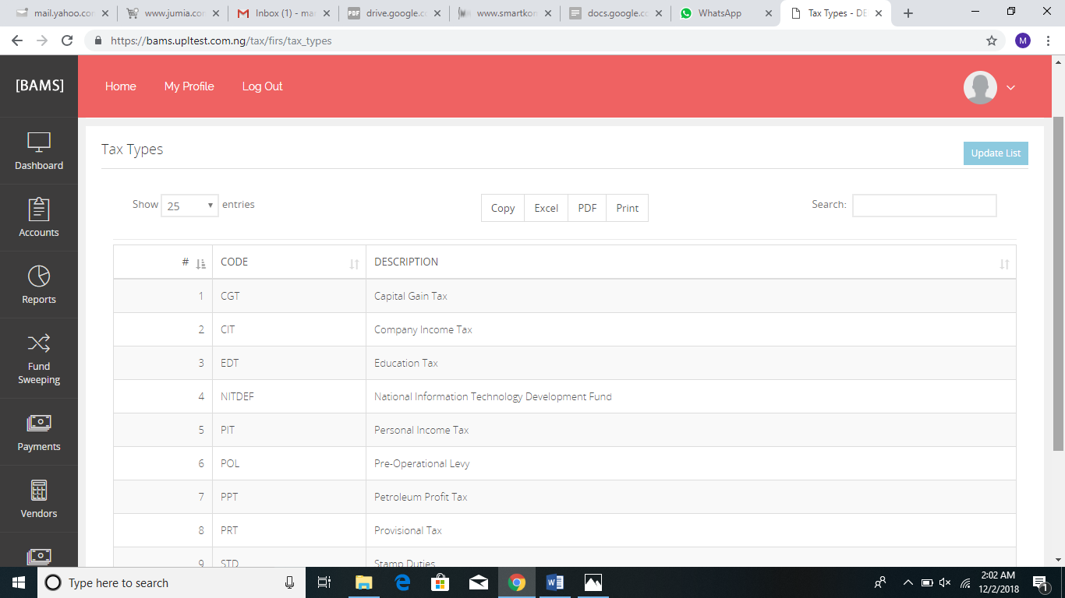
TAX TYPES
Describes a list of all tax types that can be paid for and remitted to the appropriate authorities.
Examples includes;
CGT (Capital Gain Tax)
PRT (Provisional Tax)
CIT (Company Income Tax)
VAT (Value Added Tax)
PIT (Personal Income Tax)
PPT (Petroleum Profit Tax)
As various tax policies and law are created, the system remains scalable to include new tax system.

Slide 9

Payment Methods
Describes the available payment options for making remittances to FIRS
The default payment method used on BAMS is the VMP (Vendor/Merchant Web Portal)
Payment method such as cards, mobile internet transfers can be done on the web interface
Cash, Bank cheque etc. is also possible via Bank Branch

Slide 10

TIN VERIFICATION
The application connects to FIRS database where an organization can verify its TIN authenticity before making tax remittances
If the TIN entered is correct, the application verifies and saves the details automatically through which subsequent remittances can be made.
If the TIN entered is wrong, then the application returns invalid as shown in the picture

Slide 11
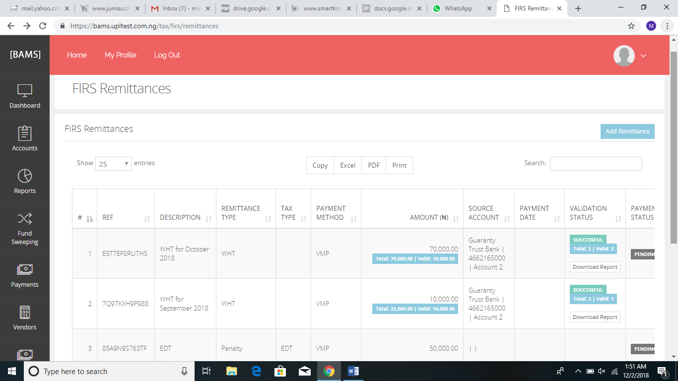
REMITTANCES
The picture displayed is used to create remittances to FIRS by clicking the add remittance button
This is used to create a payment file to be used to make remittances to FIRS by undergoing a payment approval process on the system after all parameters has been properly entered

Slide 12
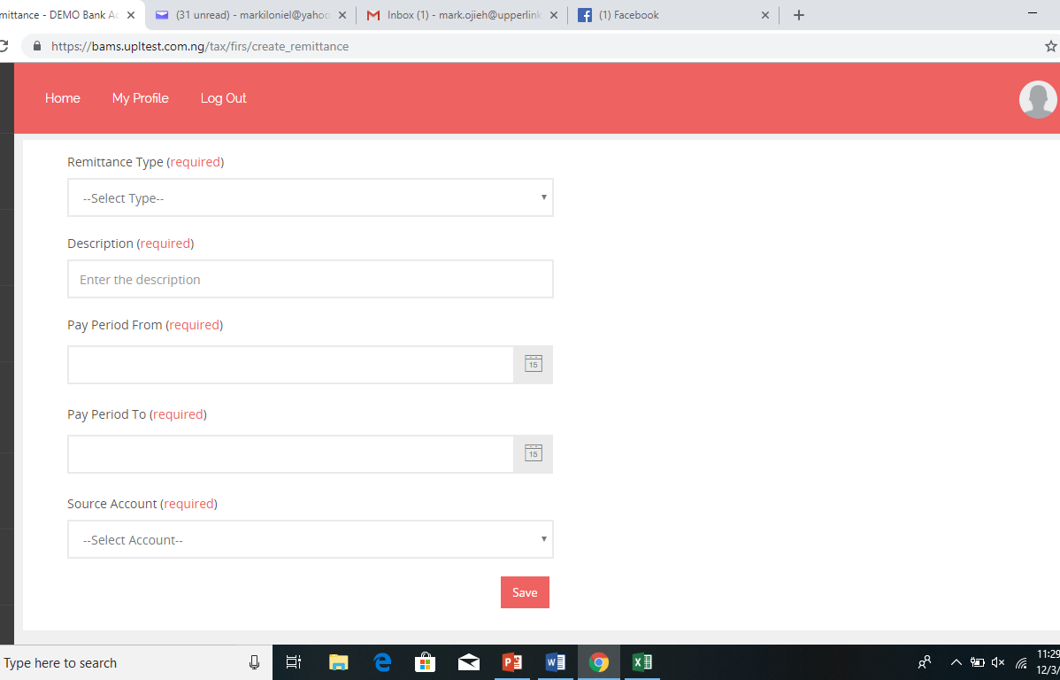
Payment CREATION
Remittance type is selected based on what is to be paid for.
NB. WHT and PAYE taxes require a file upload with the format of the file placed within the system,
A description of the type of tax to be paid and for what purposes is recorded as well as the payment period.
Source account of the organization from where the tax would be remitted is selected and the payment record is saved

Slide 13
FIRS REMITTANCE PROCESS FLOW
Company verifies TIN and the system saves automatically
Company clicks on add remittances and creates a payment record
Payment record is saved and initiated.
Payment approval workflow is initiated and the authorized users of the application visits the payment module
Click on List payments and the payment record is found with the FIRS caption
Payments are then forwarded, approved and authorized depending on work approval levels.
Once the payment approval process is successful, FIRS gets credited in real time while a payment notification report is generated and sent to FIRS

Slide 14
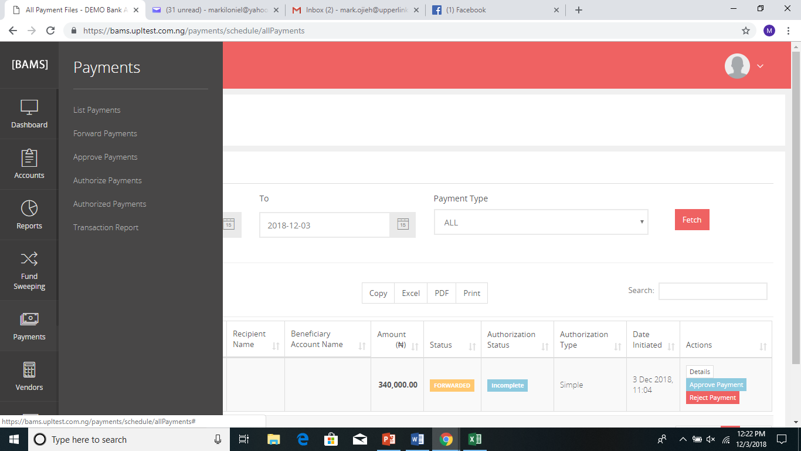
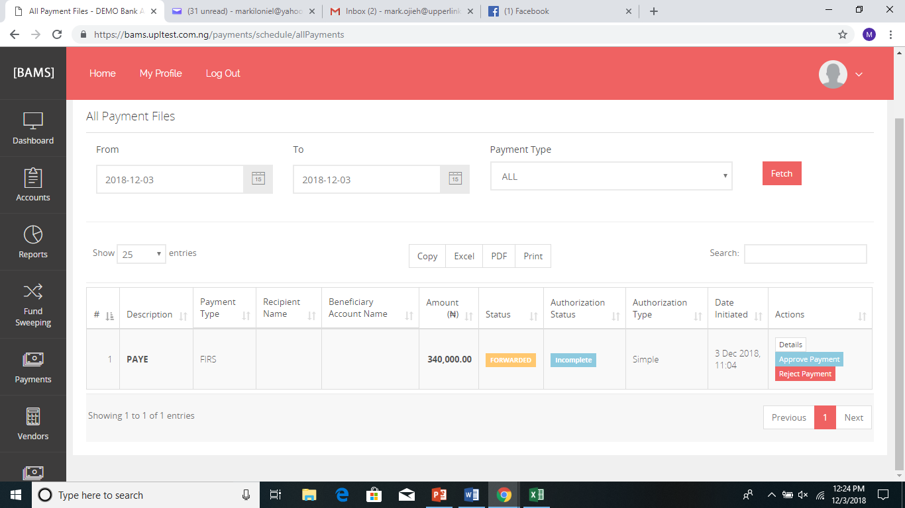
Payment approval process

Slide 15
BENEFITS
The solution makes it possible for FIRS to get its remittances at transaction time and in real time as payments such as WHT can be done by institutions when making payments of any sort.
It provides ease of convenience for making future tax payments as records are saved automatically when a remittance is initiated the first time. Suitable for businesses with frequent transactions
It is highly transparent process and very well secured
It helps to regulate tax compliance by the general public as organizations would not have difficulties in knowing where and how to remit taxes as it provides several options on the remittal processes (Bank branch and Online web platform)

Slide 16
Conclusion
In order to improve the tax revenue generation in the country for sustainable growth, the following adoption is suggested
There should be a broad base tax strategy focusing on all key areas of the tax system with measurable outcomes.
Focus should be on simplification of the tax system and ease of implementation with priority
Tax authorities should undertake significant enlightenment and public awareness and take advantage of technology and innovation including social media.
If the Government is willing to increase its revenue generation in the nearest future, adoption of the new technology by Smartkomms FIRS gateway solution is the reliable way to go

Slide 17
Thank you

